Slide 1

Algorithm based asset allocation
Final Project –UCI data analytics and visualization bootcamp

Slide 2




Team members
Aalok Devkota
Adrianne Miller
Saurabh Goyal
Gurcharan Singh

Slide 3

Our Project

Slide 4
Timeline of data
1998-2018 training and tests
2019 validation
Yahoo Finance
XLF – Financials (Banks, Insurance) XLI – Industrials (aircrafts, heavy-machinery) XLP – Staples (tooth-paste, basic necessities) XLY – Discretionary (large items , 5K tv, new car) XLK – Technology (software, hardware) XLU – Utilities (gas, electric) HY – High-yield (junk-rated bonds) VBMFX – Bond (Total Bond market) SPY – S&P 500 (S&P 500)

Slide 5
Tools and technology used
Python- Pandas,
Matplotlib, Seaborn
HTML/CSS/Bootstrap,
JavaScript, Plotly, R
JavaScript D3.js, flask
Machine Models:
Random Forest- Grid Search,
Linear Regression,
Logistic Regression

Slide 6
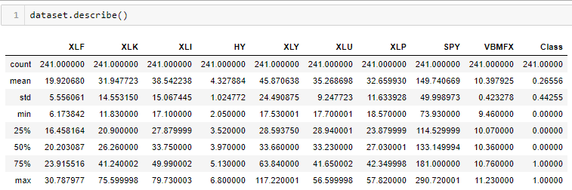
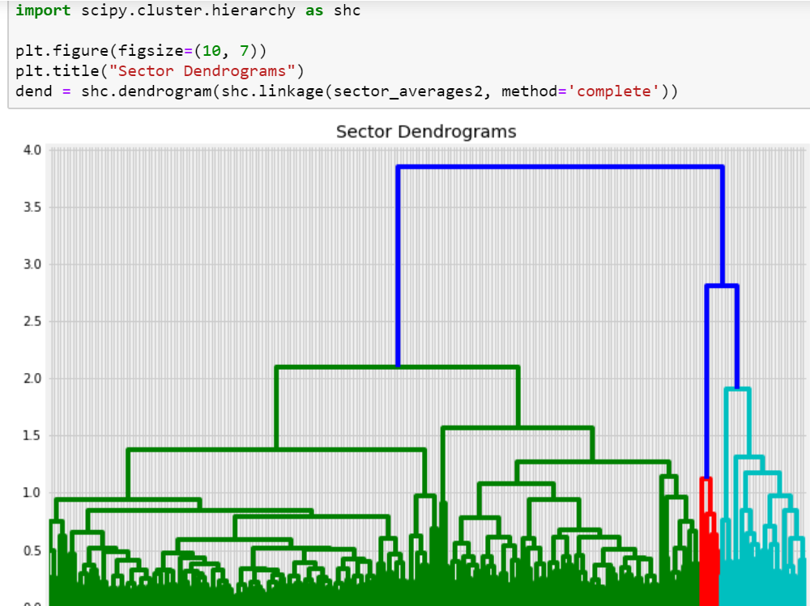
Data cleansing and clustering

Slide 7
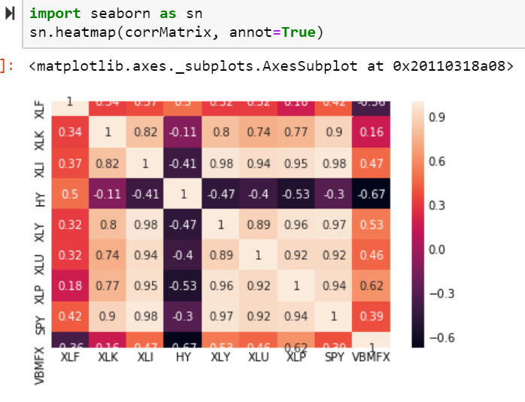
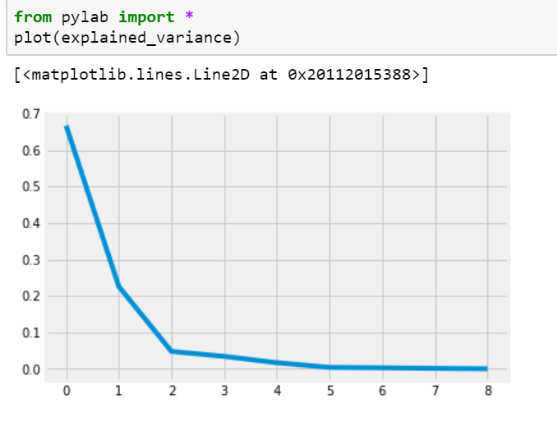
Correlation Matrix and PCA

Slide 8
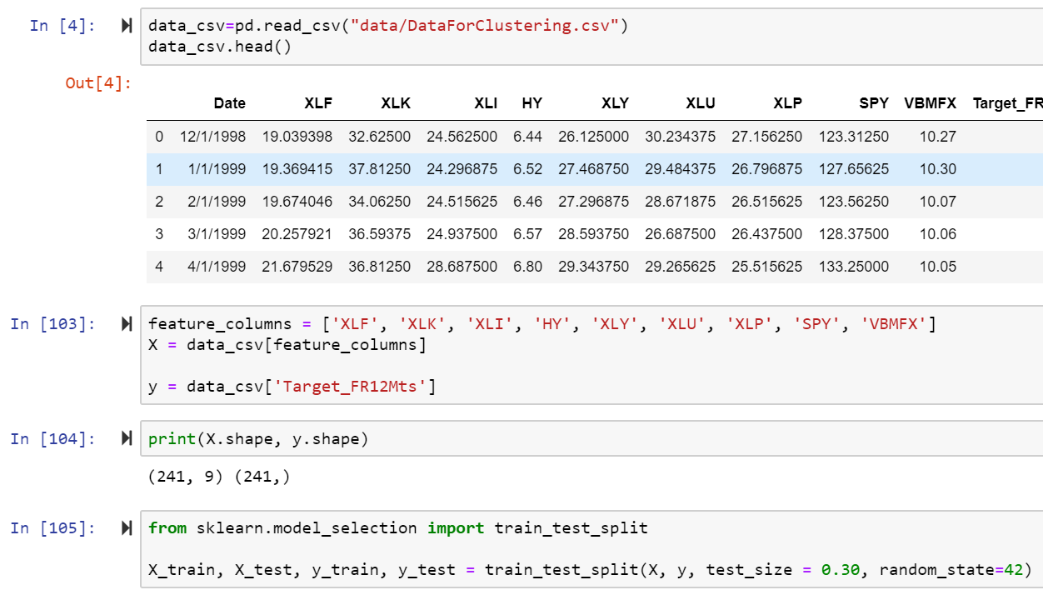
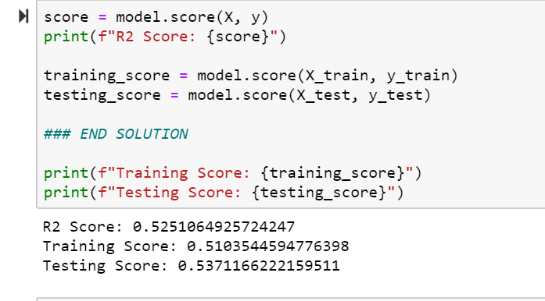
MULTIVARIATE LINEAR REGRESSION

Slide 9
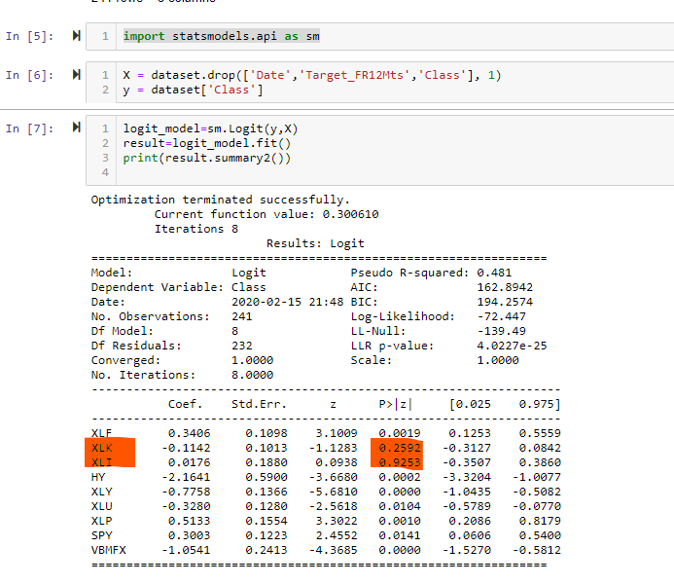
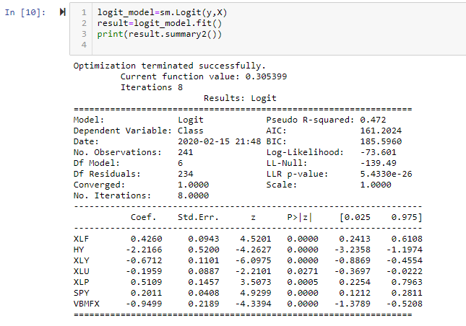
Logistic Regression

Slide 10
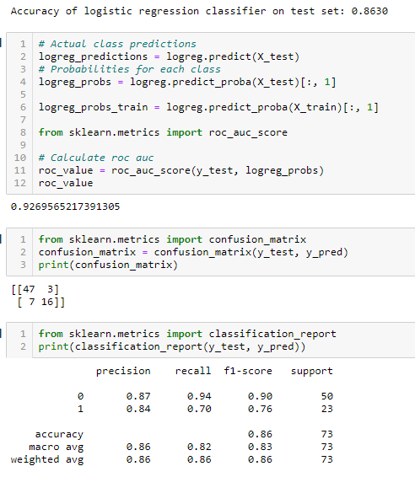
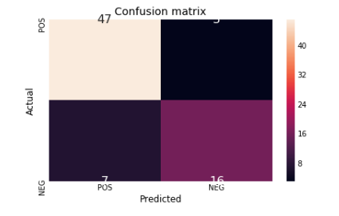
Logistic regression results

Slide 11
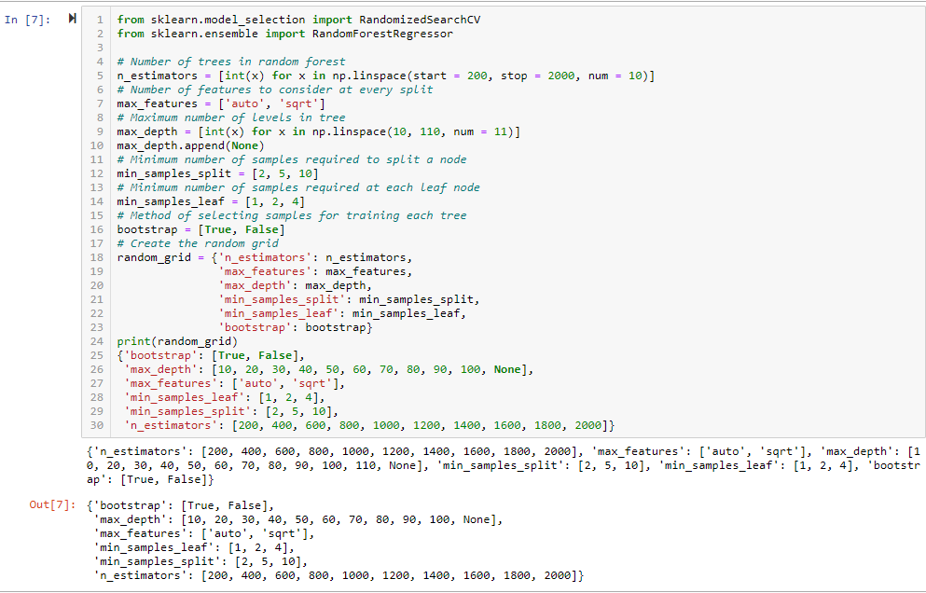
Random forest- grid search

Slide 12
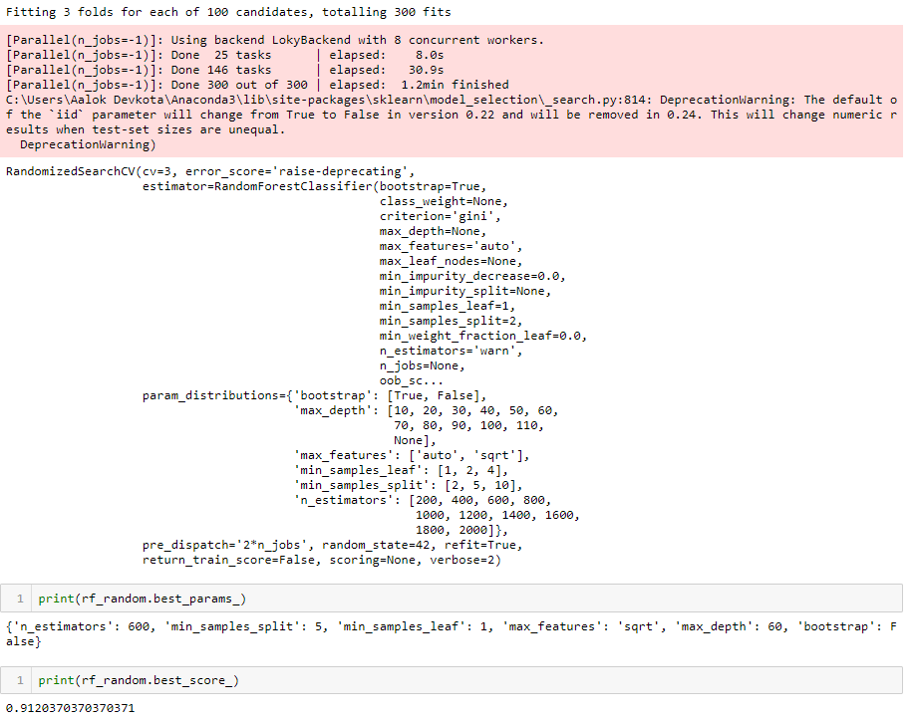
Random forest- grid search results

Slide 13
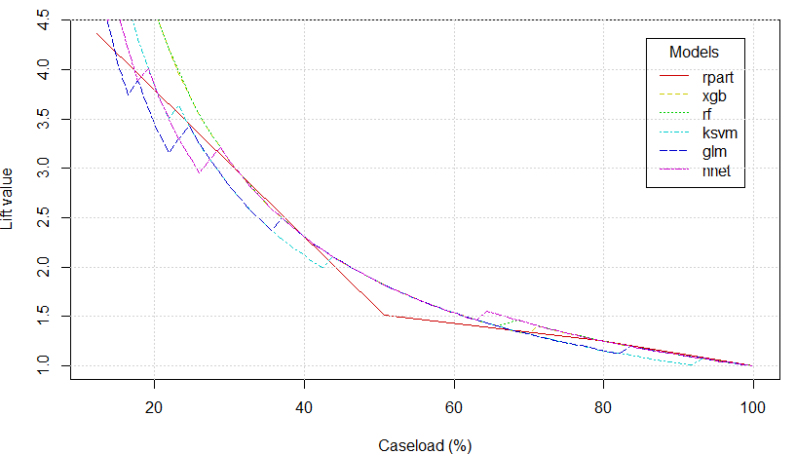
LIFT chart - “R”

Slide 14
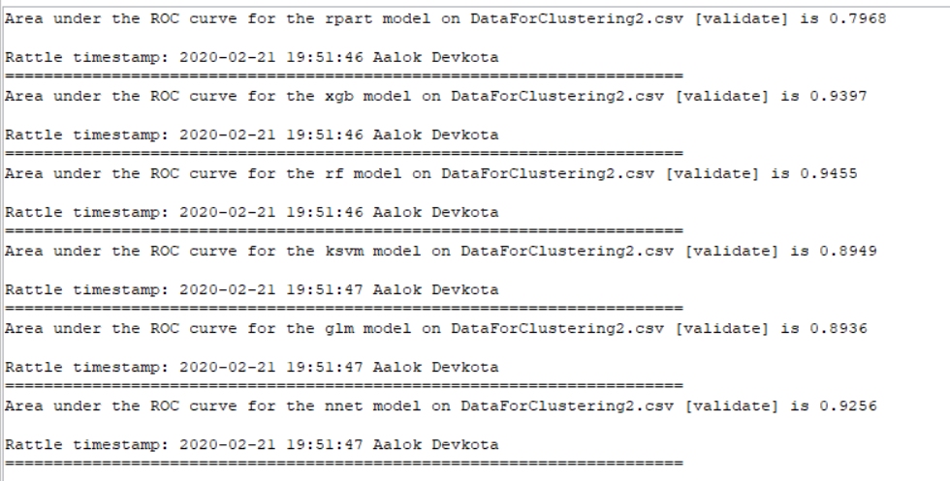
Analysis using “R”

Slide 15
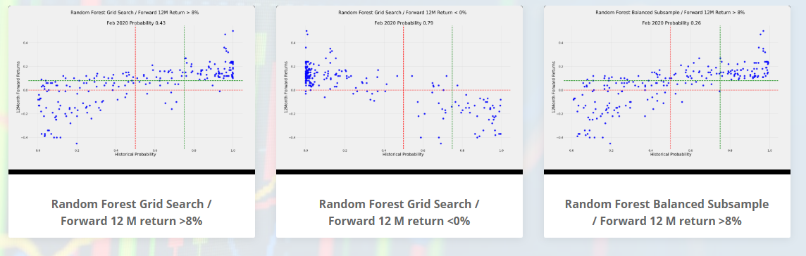
Visualization
https://investowiz.herokuapp.com/

Slide 16

Q & A

